Slide 1
Scouting America
Leave No Trace Instructor Course

Slide 2
Mission and History of Leave No Trace

Slide 3
Objectives
Goals: As a result of this session, each participant should be able to:
Discuss why the federal land management agencies became interested in emphasizing education as an alternative to regulation.
Discuss how the U.S. Forest Service initiated the Leave No Trace program and the role played by the National Outdoor Leadership School.
Explain how the Leave No Trace, Inc. was started and its current role and mission.
Discuss the role that Scouting America and other non-agency organizations play in the implementation of the Leave No Trace education program.
Notes:
These are the session goals of the Level 1 course, we do not specify a difference in the Level 2 course guide

Slide 4
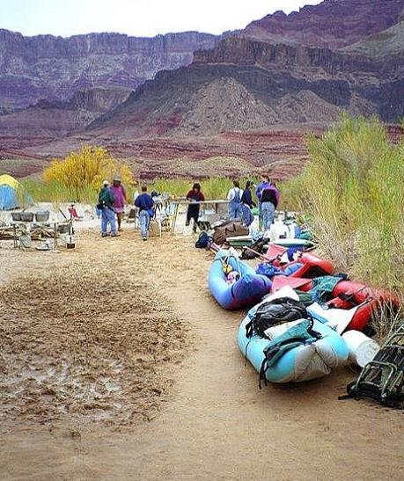
Loving Our Public Lands to Death
Increasing visitation
= Increasing impacts?
Notes:
Recreation use of public lands has increased since the 1950’s and along with it, recreational impacts. Since 1950, the National Park Service has recorded a 10-fold increase in annual visitation with 331 million visits in 2024. The US Forest Service reported a 600% increase in the same time period with 148 million visits in 2024.
1950 to 2020 - National Park visitation increased from 33 million to 327 million
National Forest visitation increased from 27 million to 173 million during the same period
1992 - Combined visitation to undeveloped public lands was estimated at 670 million
2016 – Dept. of the Interior estimated 870 million visits to federal land
2018 – Association of American State Parks estimated 800 million visits to state parks

Slide 5
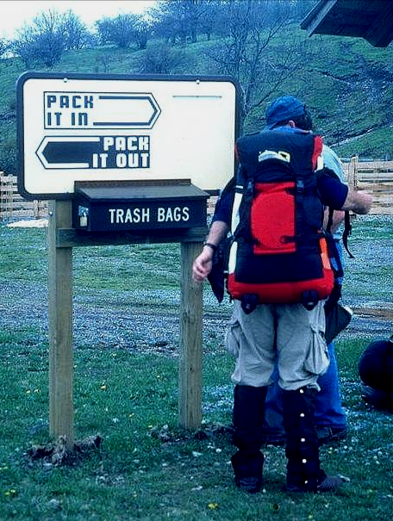
Conception and Early Development
1960’s – Low-impact educational efforts originated in backcountry and federally-designated Wilderness areas
1970’s - Federal agencies began developing educational brochures with slogan-based programs:
  Wilderness Manners
  Wilderness Ethics
  Minimum-Impact Camping
  No-Trace Camping
Notes:
Example slogans:
Wilderness Manners
Wilderness Ethics
Minimum-Impact Camping
No-Trace Camping
Give a Hoot, Don’t Pollute
Only you can prevent wildfires

Slide 6
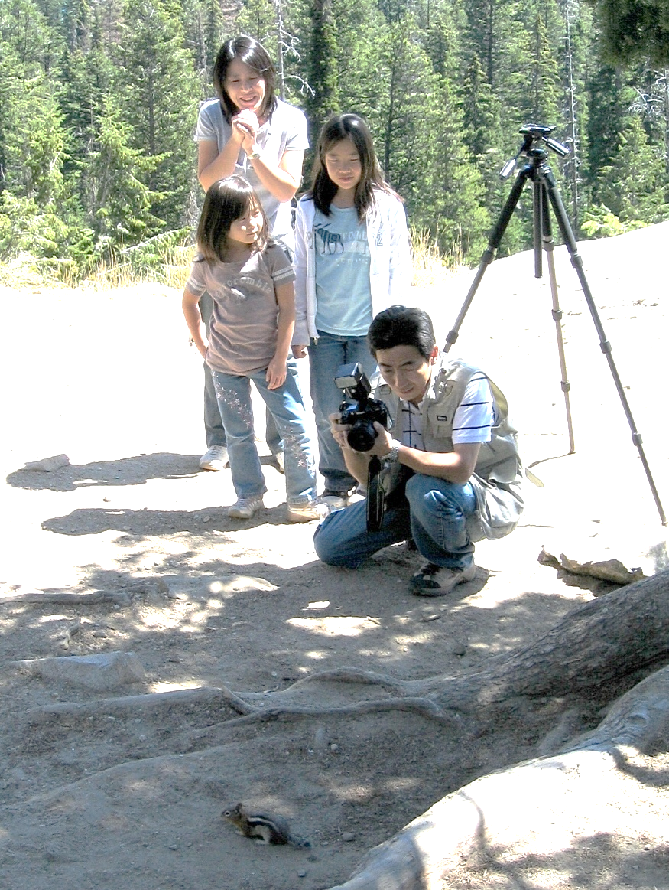
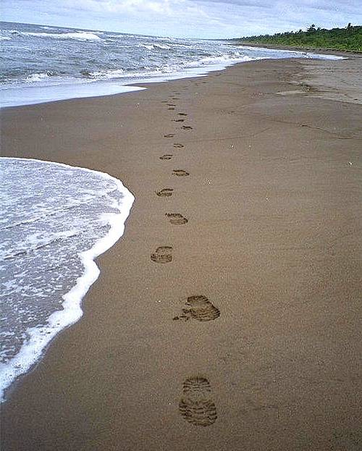
Take Only Pictures…
Leave Only Footprints

Slide 7
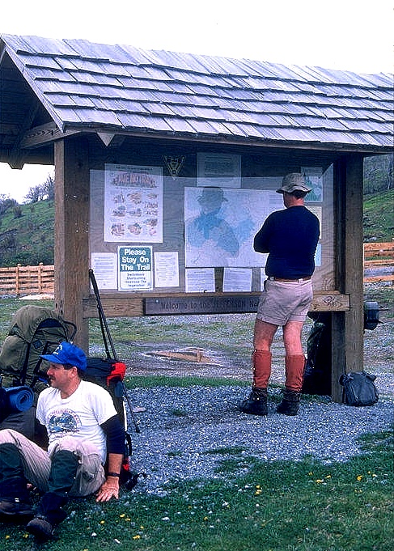
Conception and Early Development
Early 1980’s – The No Trace program developed by U.S. Forest Service wilderness managers:
    Low-impact hiking and camping practices
    Humanistic approach for wilderness ethics
Late 1980’s - Program success led to cooperation with the Bureau of Land Management and National Park Service

Slide 8
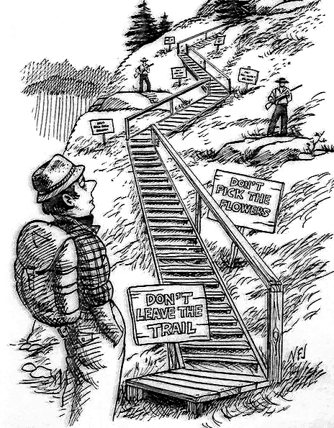
Regulation or Education?
Regulations antagonize the public … …education wins their support.
Most impacts are not due to malicious acts.
Education improves knowledge of consequences and promotes low-impact practices.
Enforcement of regulations is difficult.

Slide 9
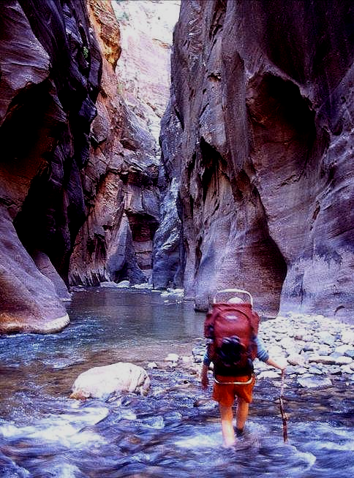
Creation of the “Leave No Trace” Program
1990 - Leave No Trace was selected as the name for an expanded national program. U.S. Forest Service (USFS) formed a partnership with the National Outdoor Leadership School (NOLS) to develop educational materials and courses.
1991 - NOLS taught the first Master Educator course in the Wind River Range, WY.

Slide 10
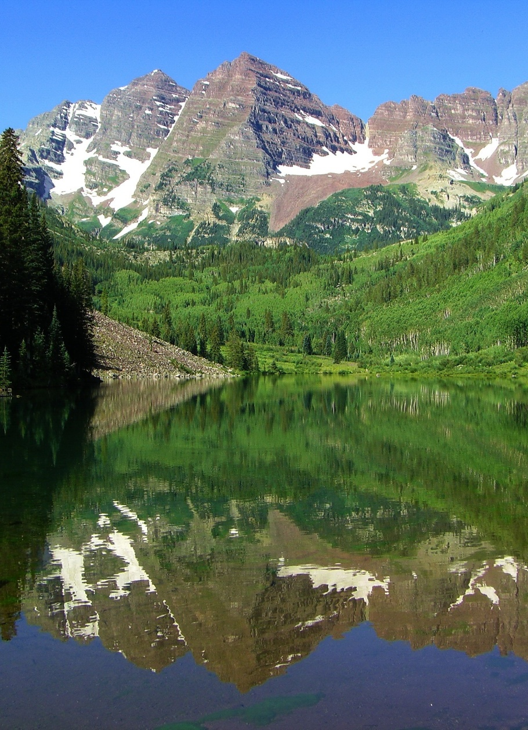
Creation of the Non-Profit
1993 - Outdoor Recreation Summit recommended creation of the non-profit LNT, Inc.
1994 - LNT, Inc. was created to guide the national program’s development, establish partnerships, distribute educational materials, and conduct fundraising.
2002 - Renamed the “Leave No Trace Center for Outdoor Ethics” (The Center).
2022 – Rebranded as simply “Leave No Trace.”

Slide 11
Leave No Trace
Mission: Using the power of science, education and stewardship, Leave No Trace is on a mission to ensure a sustainable future for the outdoors and the planet.
No matter where or why you get outside, it’s yours to protect.
It’s Your Nature.

Slide 12






Leave No Trace Partners
Partners with federal & state agencies, manufacturers, retailers, communities and others to promote minimum impact messages.
U.S. Forest
Service
National Park
Service
Bureau of
Land Management
U.S. Fish &
Wildlife Service
U.S. Army Corps
of Engineers
Nat. Association
of State Park Dir.

Slide 13
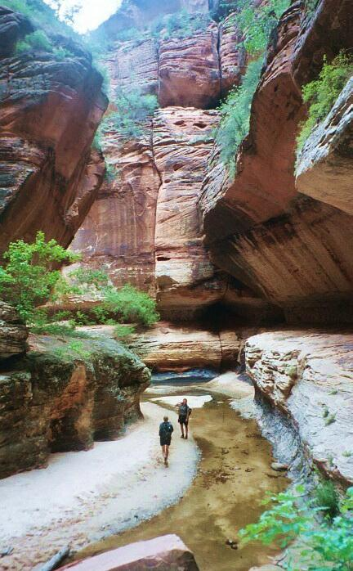
Current Status
Leave No Trace is located in Boulder, CO, and guided by a Board of Directors with corporate, non-profit and government representatives.
> 3 million budget; staff: 15 permanent staff & 3 teams of traveling educators.
Funding primarily derived from partnerships and grants (63%), individual giving (16%), and program services (12%).
(As of: Oct 2024)

Slide 14
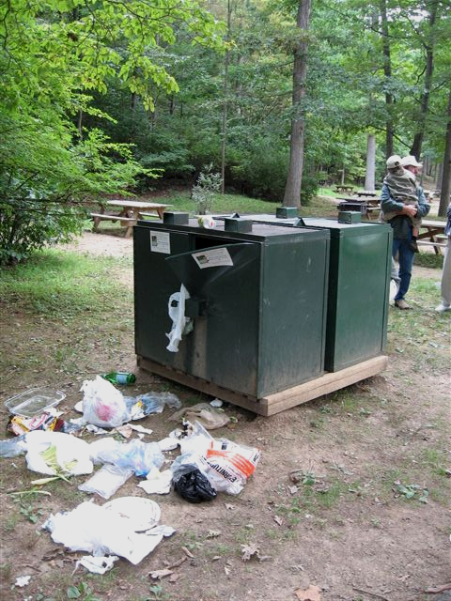
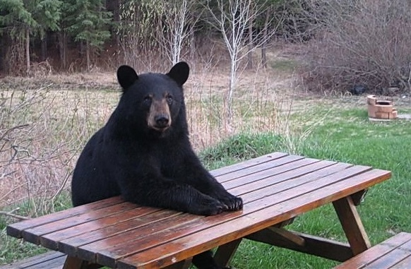
Evolving Focus
The Leave No Trace program began with a focus on Wilderness and the federal agencies, but has evolved to encompass backcountry, frontcountry, and urban settings.
Frontcountry
Notes:
Most Scouting takes place in the Frontcountry.

Slide 15

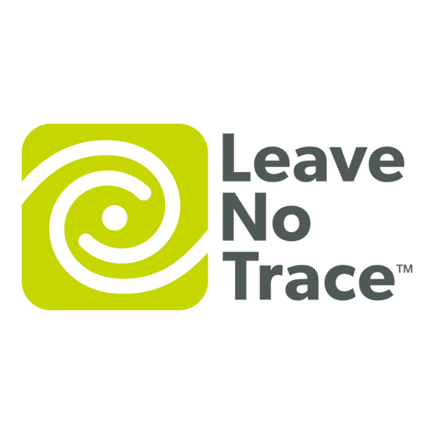


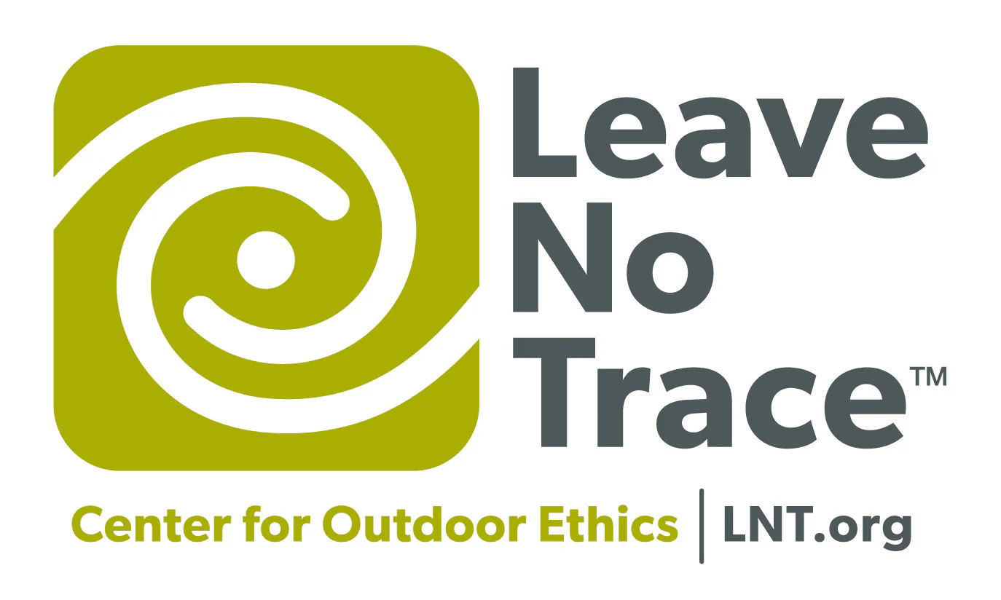

Evolving Logos
2024 – Present
2001-2004
2010 - 2014
2014 – 2016
2016 – 2021
2022 – 2024
Notes:
Don’t dwell on this slide. The key points are:
You may come across various older logos for Leave No Trace - they have changed many times over the years. Please use only the latest logo on all your presentations and course promotion materials (flyers and web info).
The Leave No Trace logo and principles are copyrighted and use of the logo is restricted. For example, you can’t put it on patches, on your business cards, on your website, … Check the Leave No Trace Brand Guidelines for authorized uses.

Slide 16
How Does Scouting America Support Leave No Trace?
Leave No Trace introduced at 1993 National Jamboree
Non-Profit Partner
Education
  Largest organizational user of the outdoors
  BSA trains more people in Leave No Trace than all other organizations combined

Slide 17
How Does the Scouting America Support Leave No Trace?
1993 – Leave No Trace introduced at National Jamboree
1998 – Venturing Ranger Award includes Leave No Trace
2005 – BSA becomes provider of ME Course
2007 – BSA forms the LNT Task Force
2007 – Council Outdoor Ethics Advocate position created
2008 – Leave No Trace Awareness Award
2010 – Leave No Trace incorporated into Boy Scout advancement
2012 – Outdoor Ethics Subcommittee
2013 – Outdoor Ethics Awareness and Action Awards
2015 – Outdoor Ethics added to Cub Scout Advancement
2016 – Outdoor Ethics Guide Position of Responsibility added for Troops and Crews
2022 – Outdoor Ethics and Conservation Subcommittee

Slide 18
Scouting America
Leave No Trace Instructor Course

Slide 19
Prepared by:
Joshua Lamothe
Revised: April 2025
Sources:
www.lnt.org
US Census
Federal Agency usage data (see notes)
Notes:
https://www.fs.usda.gov/sites/default/files/2020-National-Visitor-Use-Monitoring-Summary-Report.pdf https://www.fs.usda.gov/about-agency/nvum
https://www.nps.gov/subjects/socialscience/visitor-use-statistics-dashboard.htm
https://www.fws.gov/sites/default/files/documents/Final_2022-National-Survey_101223-accessible-single-page.pdf
https://www.performance.gov/cx/dashboard/actionplans/2020/2020-hisp-action-plan-doi-fws.pdf
https://www.fws.gov/program/national-survey-fishing-hunting-and-wildlife-associated-recreation-fhwar#:~:text=Our%20Services,%2C%20sex%2C%20and%20other%20demographics.
https://www.blm.gov/sites/blm.gov/files/docs/2021-08/PublicLandStatistics2020.pdf https://www.blm.gov/sites/blm.gov/files/pls10.pdf
https://archive.org/details/publiclandstatis1989unit/page/n1/mode/2up

